Slide 1

A Clustering Analysis in Community Resilience to Natural Disasters
Mateng Cheng
June 14, 2024

Slide 2
Background
In recent years, climate change increases
Frequency and intensify of extreme weathers
Sea-level and sea surface temperature
Heat waves
And from 1980 to 2024, Billion-dollar events in the United States include:
195 Severe Storms
62 Tropical Cyclones
44 Floods
31 Droughts
24 Winter Storms
22 Wildfires
9 Freezes
Notes:
which destroy thousands of houses and causes millions of people dislocated

Slide 3

387 Events,
2.743 Trillion Dollars
Google Inc.
2.207 Trillion Dollars
Notes:
Market Value

Slide 4
01
02
03
OBJECTIVE
METHODOLOGY
LIMITATION
Notes:
Three parts

Slide 5
OBJECTIVE
01
Define and measure community resilience capacity
Quantify disaster impact and recovery time
Socioeconomic and racial disparities in resilience capacity and evacuation patterns
Notes:
three objectives

Slide 6
Methodology
02
Define and measure community resilience capacity
Quantify disaster impact and recovery time
Socioeconomic and racial disparities in resilience capacity and evacuation patterns
Notes:
A very interesting part is that in this part, the author used a clustering analysis, which I will talk in details later

Slide 7

Data collection
More than 800,000 anonymized mobile devices in Houston, Texas, representing approximately 35% of the local population, in response to Hurricane Harvey in 2017.
Notes:
Big data

Slide 8
The initial dataset of 23TB of compressed comma-separated-value files (CSV) covering the period from June 2016 through October 2017 and contains more than 320 billion data points.
This paper used data for the 2-month period between August 1st, 2017 and September 30th, 2017

Slide 9
Other Data Source
Original Houston Harris County parcel level land use information data (Texas Natural Resources Information System website)
Houston park and open space (the City of Houston GIS Open Data Portal)
Harris County evacuation zones (the Harris County Emergency Management)
Texas major roads including highways (Texas Department of Transportation and the Houston Department of Transportation)
Notes:
open source

Slide 10
Clustering Analysis
An unsupervised machine learning technique
Notes:
As I mentioned earlier

Slide 11
Clustering Analysis
Introduction
DBSCAN (Density-Based Spatial Clustering of Applications with Noise) is a density-based clustering algorithm used to discover clusters of arbitrary shapes in data and to identify noise points. It is widely used in spatial data mining and big data analysis.
Advantages
(1) that it does not require a priori information about the number of clusters
(2) the clusters can be of arbitrary shape deﬁned by the chosen distance measure
(3) the algorithm is robust to outliers identiﬁed as noise (not belonging to any of the clusters).
Notes:
Two parameters required to be speciﬁed are the distance between the observation points (ε) and minimum number of points required to form a cluster (n).

Slide 12
Clustering Analysis
Objective:
Reveal different disaster response and recovery patterns.
Process:
To classify communities into distinct groups based on changes in their activity levels before, during, and after Hurricane Harvey, using an unsupervised machine learning technique—hierarchical clustering.
Notes:
DBSCAN (Density-Based Spatial Clustering of Applications with Noise) is a density-based clustering algorithm used to discover clusters of arbitrary shapes in data and to identify noise points. It is widely used in spatial data mining and big data analysis.

Slide 13

Results and Validation

Slide 14
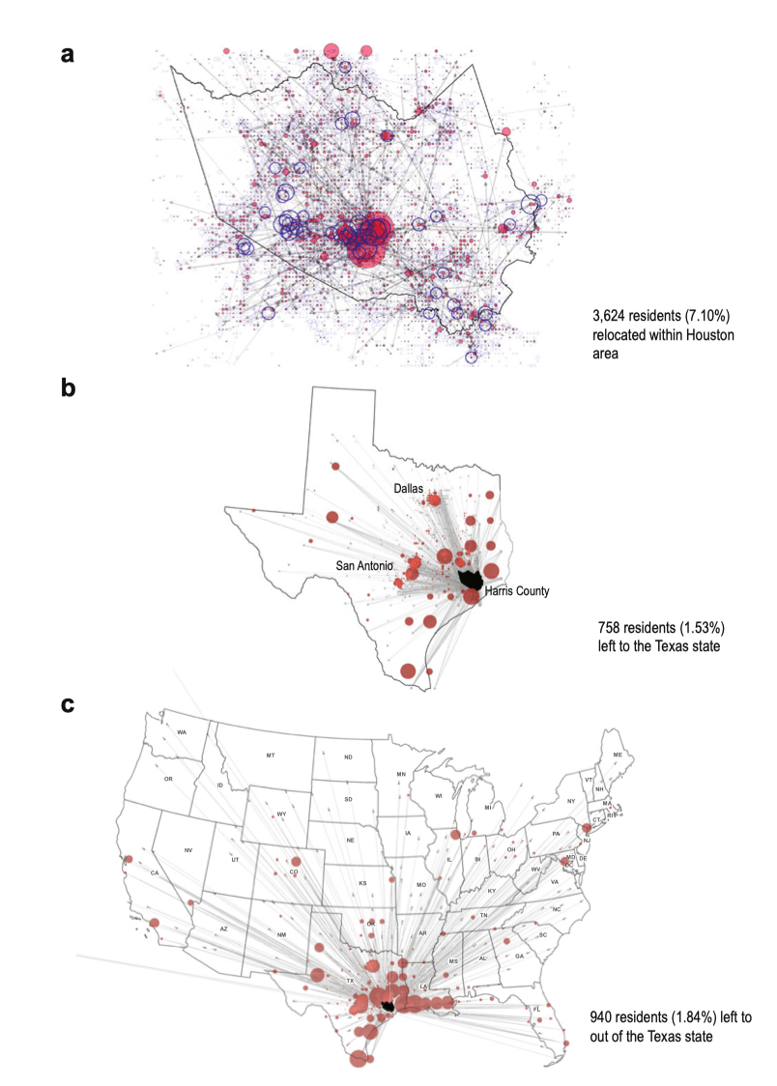
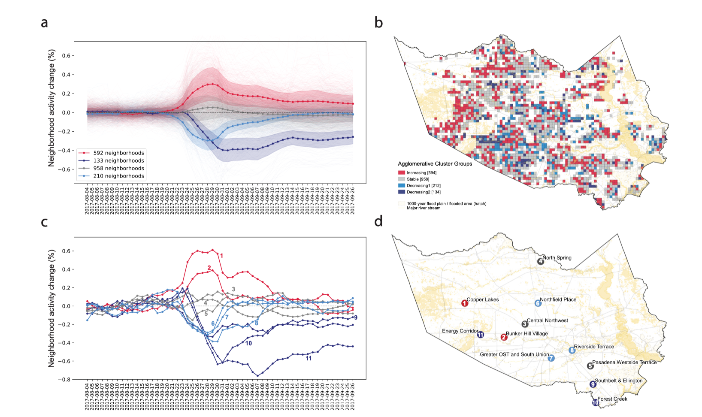
Disaster response and recovery patterns
An important component of our approach is its generalizability and scalability: using the same or similar dataset, the methodology can be applied to other extreme or unexpected events, beyond natural disasters.
Fig. 1 Distinct neighborhood groups based on disaster response and recovery patterns
Fig. 2 Disparities in evacuation patterns during Hurricane Harvey
Notes:
a This time series plot shows community activity level trends over the time period from August 4th through September 26th. The agglomerative clustering algorithm identiﬁes four distinct groups that represent similar patterns of disaster response and recovery at the neighborhood level. Plots denote mean activity of each cluster with one standard deviation uncertainty band.
b The map shows spatial patterns of identiﬁed clusters. Most dark blue neighborhoods show a signiﬁcant decrease in community activities due to devastating ﬂooding near reservoir areas.
c Illustrative neighborhood activity curves for each cluster group associated with their location in (d).
-----------------------------------------------
a 3624 residents (7.10% of the total sample) left their home neighborhood but stayed within the Houston area. Blue dots denote the outbound number of people and red dots denote the inbound number of people for a given neighborhood. Many people in the west area near reservoirs were forced to leave their home due to ﬂooding during and after Harvey. People who left their neighborhood mostly evacuated to the Downtown area where multiple mega-shelters were located
(b) 758 people (1.53% of the total sample) traveled to other parts of Texas (outside of the greater Houston area). Major destinations of those evacuees are College station, San Antonio, and Dallas where additional shelter programs were operating.
c 940 people (1.84% of the total sample) left the Houston area to other states including Louisiana, New Mexico, and California. Most evacuees traveling out of Texas headed to Louisiana, the nearest neighboring state.
All codes are open source and in GitHub repository.

Slide 15
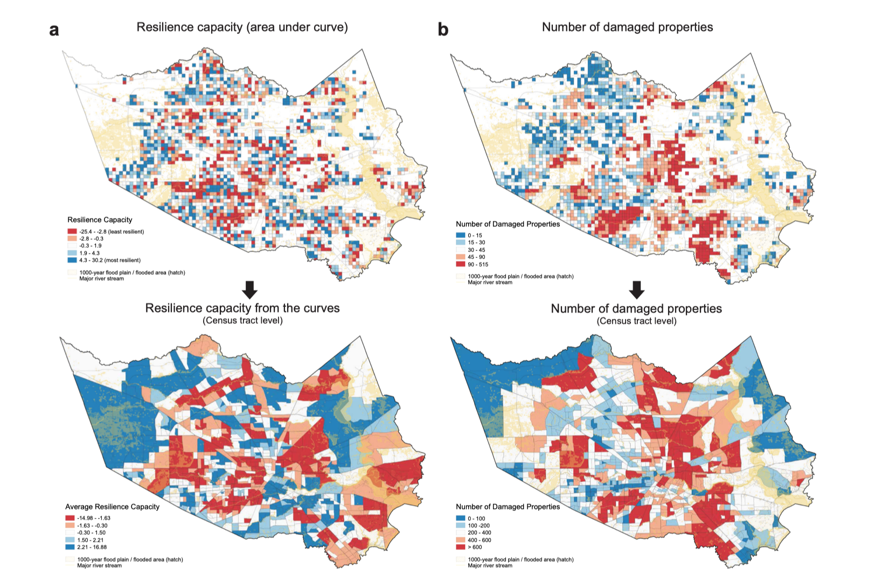
Validation with FEMA data
Fig. 3 Validation of neighborhood resilience measure

Slide 16
03
Limitations

Slide 17
03
Limitations
Data Source and Representativeness:
Selection Bias: smartphone which may not represent low-income people and elder populations
Data Coverage: the data only cover users who had location services enabled on their devices
Short-term Focus: The analysis primarily focuses on short-term evacuation and immediate post-disaster recovery. It may not fully capture the long-term recovery process and the lasting impacts of the disaster on communities.
Resilience Capacity Calculation: The Area Under the Curve (AUC) method to quantify resilience capacity integrates both the magnitude of impact and recovery duration. However, it might not account for all dimensions of resilience.

Slide 18
Research opportuinity
Collect data source includes more dimensions: social, economic, climate etc.
Long-term Focus: evaluate the long-term recovery and resilience in the coastal region.
Resilience Capacity Model: Use better numerical model to calculate the resilience capacity.
Prediction: Use current resilience level to predict different scenarios in the future

Slide 19
REFERENCE
Hong, B., Bonczak, B. J., Gupta, A., & Kontokosta, C. E. (2021). Measuring inequality in community resilience to natural disasters using large-scale mobility data. Nature communications, 12(1), 1870.
Code availability (https:// github.com/UrbanIntelligenceLab/measuring-inequality-in-community-resilience-tonatural-disasters)
Texas Natural Resources Information System (https://data.tnris.org/collection/2679b514-bb7b-409f-97f3ee3879f34448)
City of Houston GIS Open Data Portal (COHGIS) (https://cohgis-mycity.opendata.arcgis.com/ datasets/coh-park-boundary)
Harris County Emergency Management (https://prepare.readyharris.org/evacuation-map)
USGS National Elevation Dataset (https://catalog.data.gov/dataset/national-elevation-dataset-ned-13-arc-second-downloadable-data-collection-national-geospatial)
FEMA (https:// www.fema.gov/ﬂood-maps/products-tools/national-ﬂood-hazard-layer and https://www. fema.gov/about/openfema/data-sets)
Rice University Houston Urban Data Platform (https://www.kinderudp.org/ #/datasetCatalog/va7b869ng5dv)
Texas Department of Transportation and the Houston Department of Transportation (https://gis-txdot.opendata.arcgis.com/datasets/ d4f7206d27af4358acb70cb1cc819d10_0 and https://cohgis-mycity.opendata.arcgis.com/ datasets/coh-major-road respectively)

Slide 20
THANKS!

